Slide 1
Intro to CLAIR lab

Slide 2
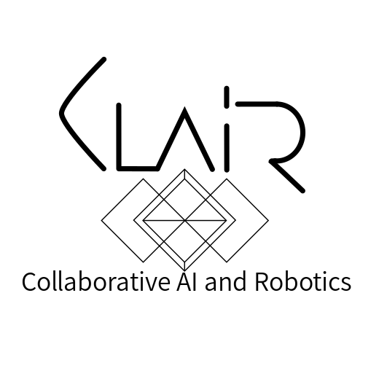
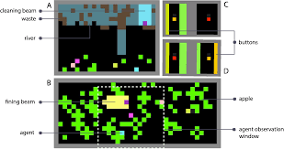
https://subsplease.org/
Notes:
Less info

Slide 3
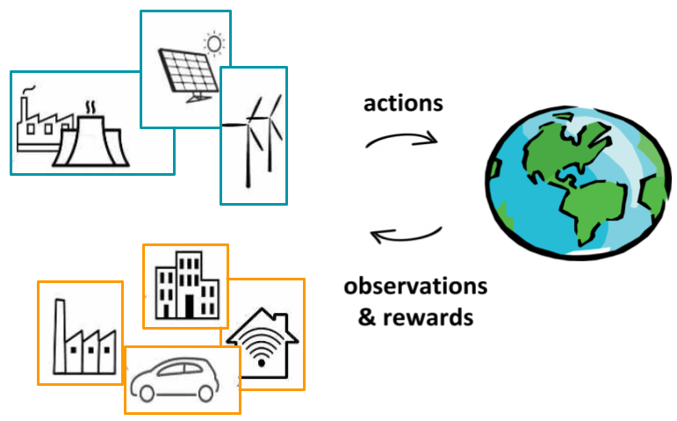
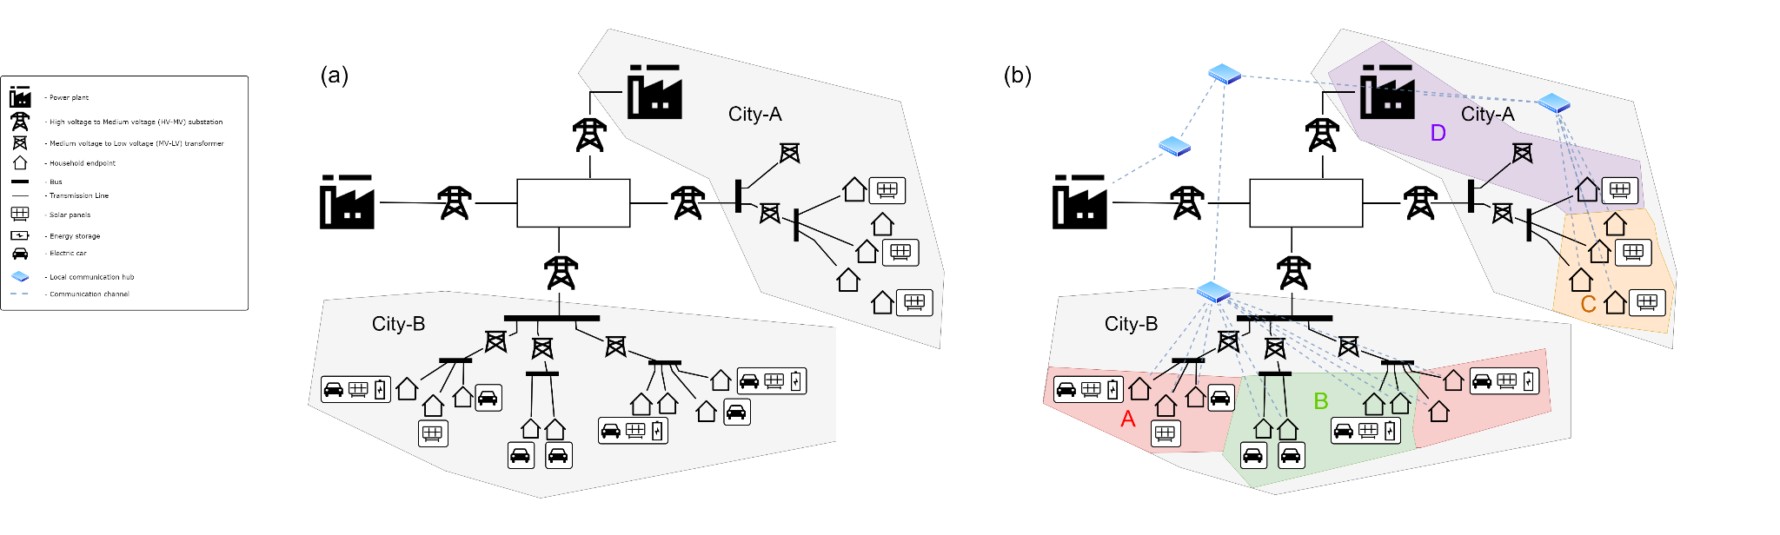
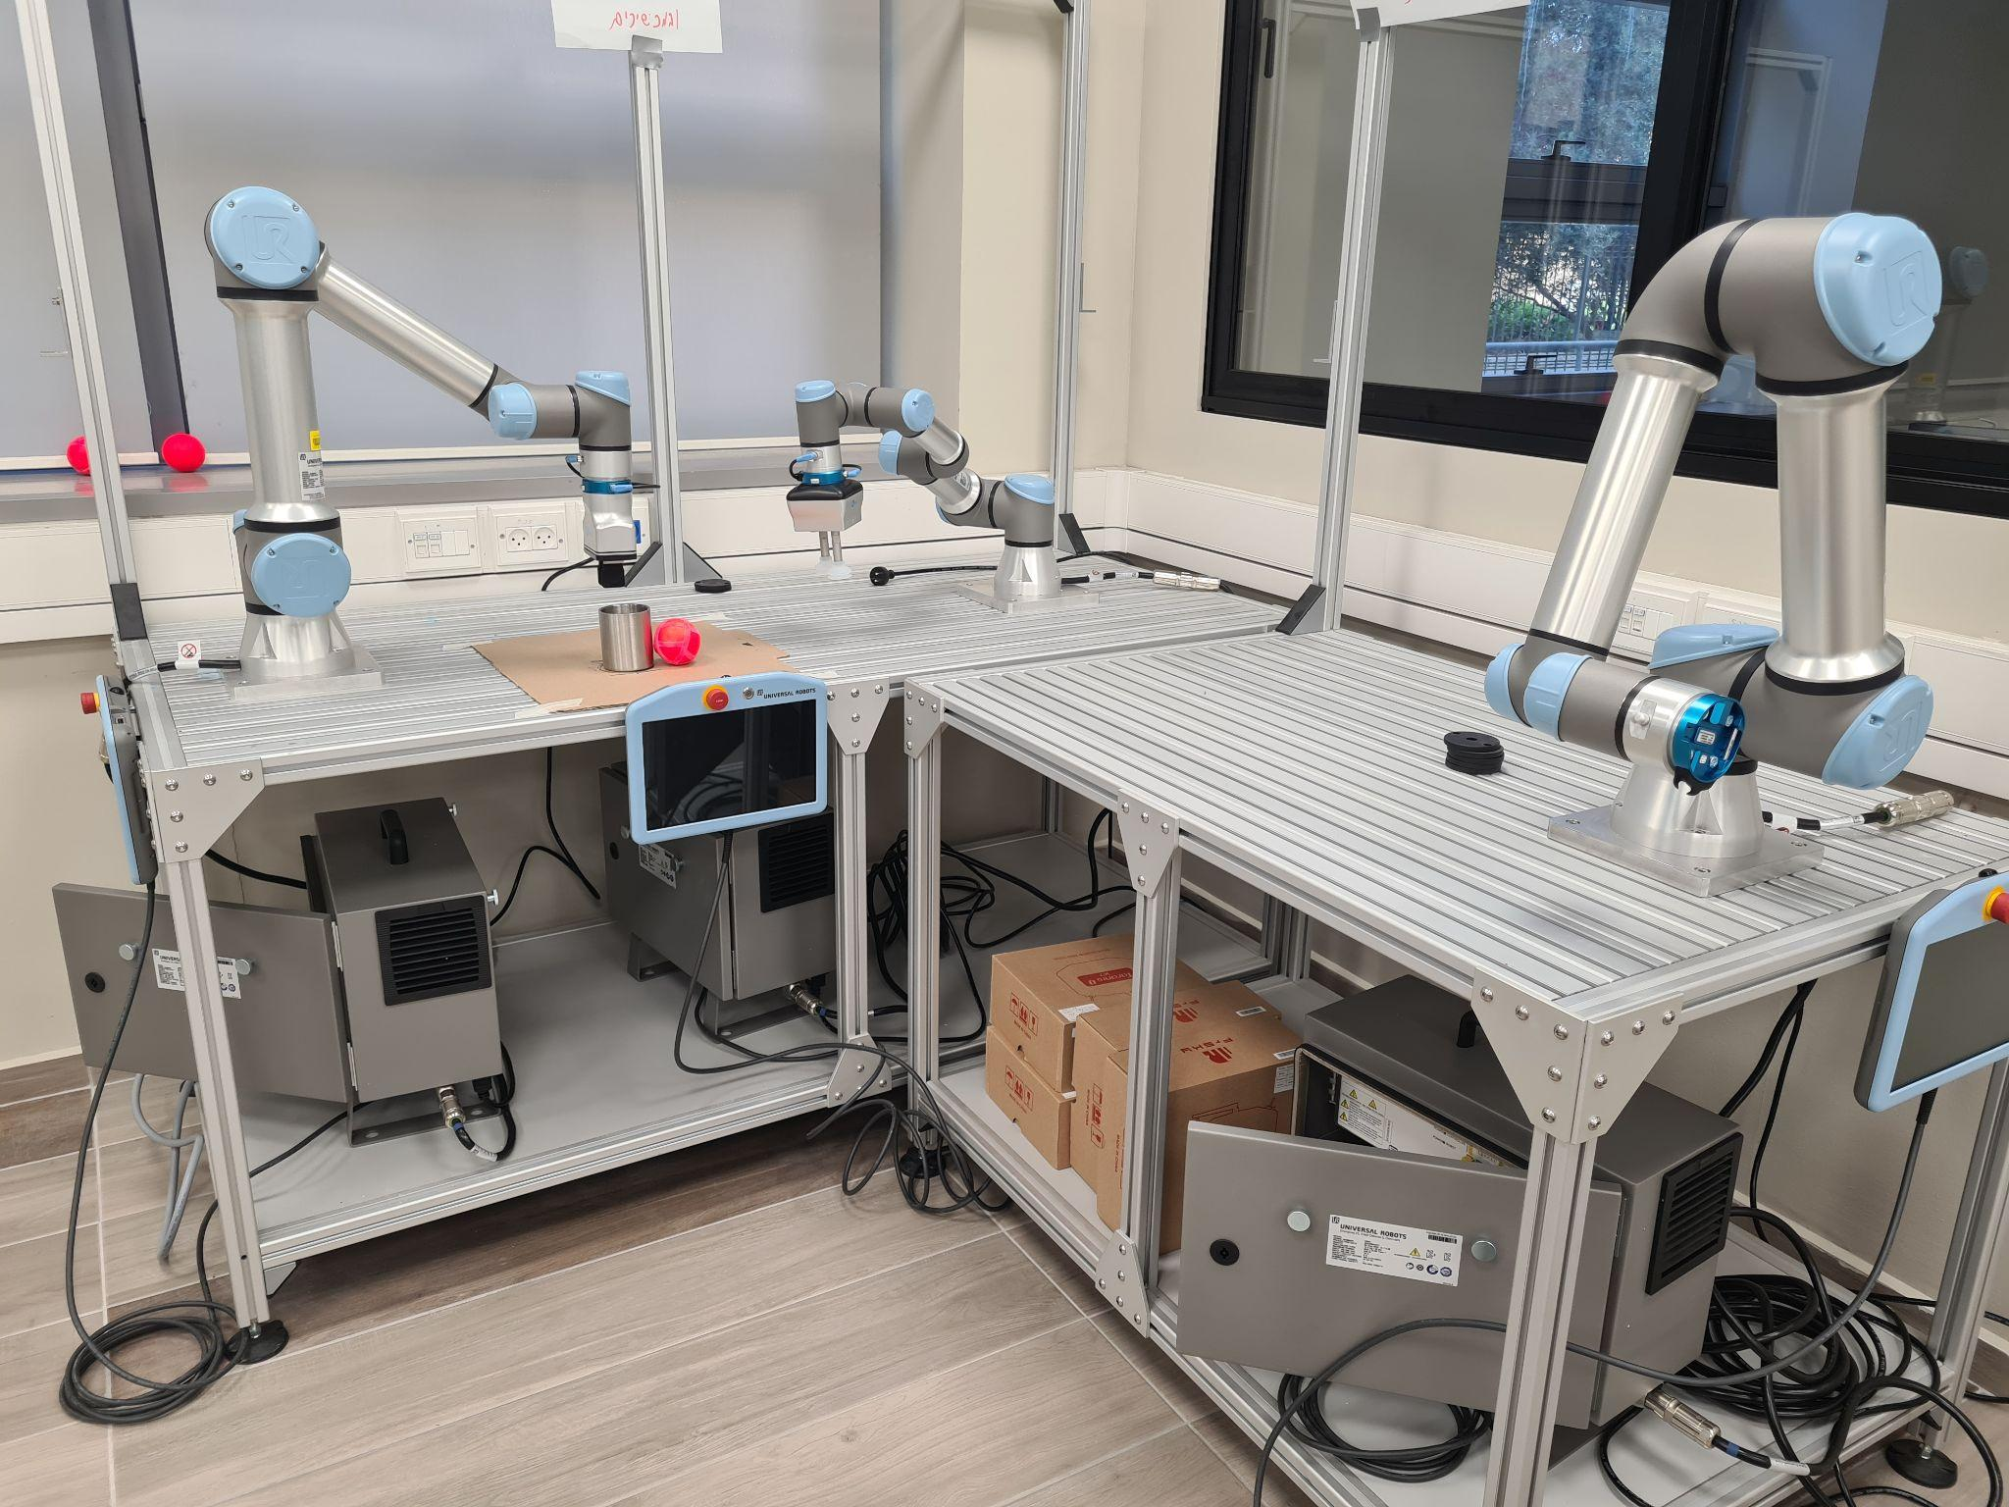
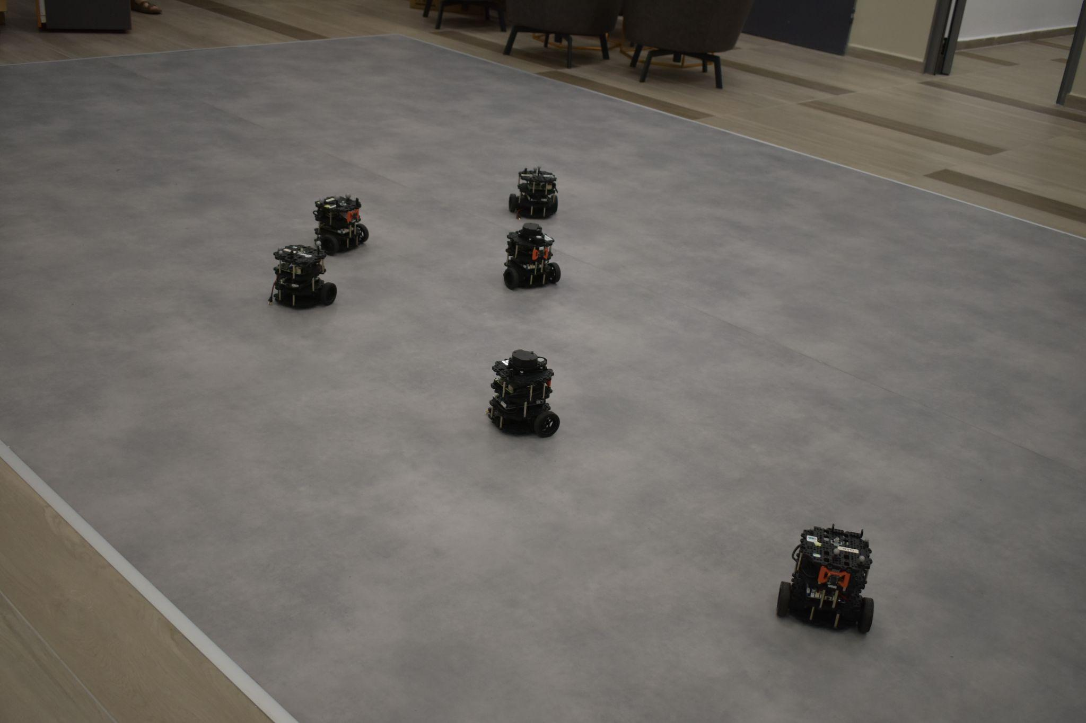
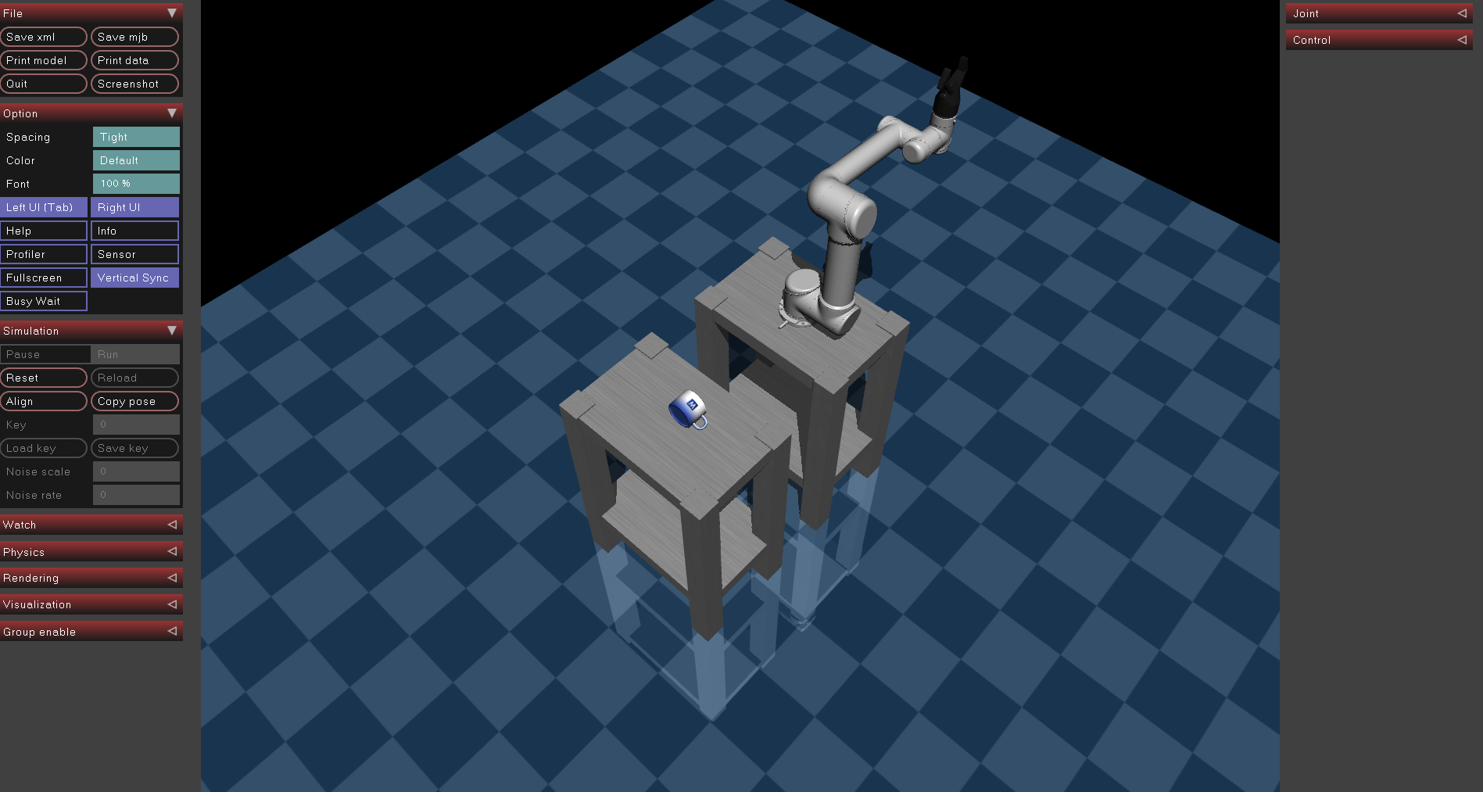
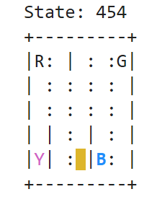
Notes:
Less info

Slide 4
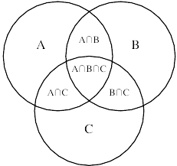
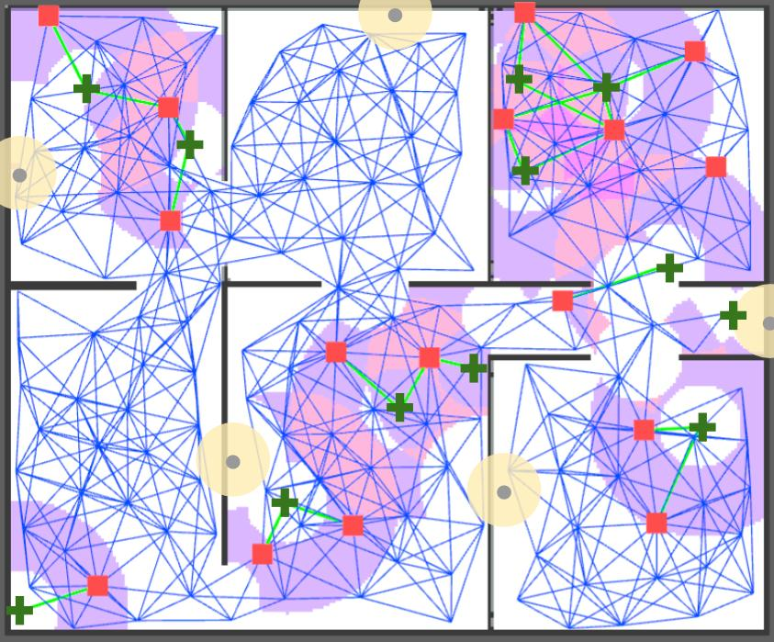
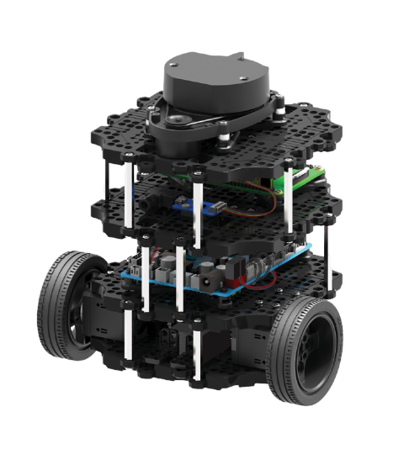

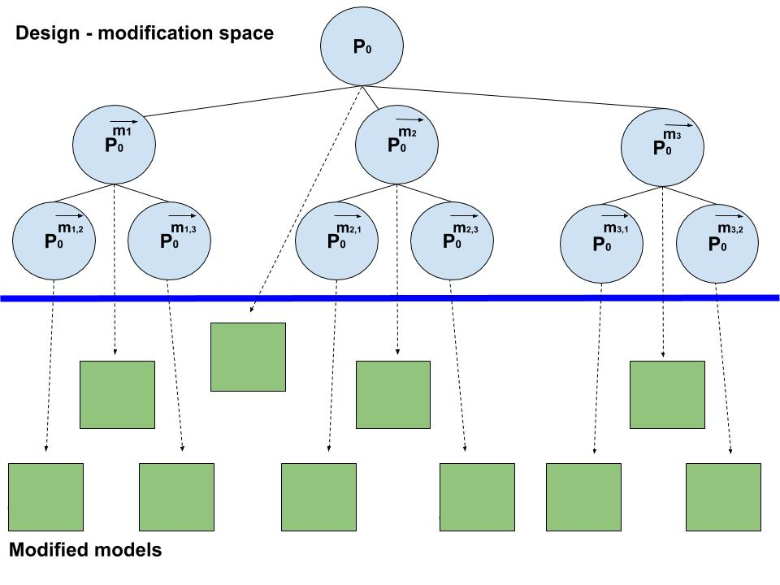
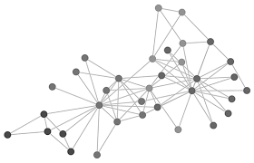
Provide theoretical foundations for designing AI systems that are capable of effective partnership in sustainable and efficient collaborations of automated agents as well as of automated agents and people.
experience (data)
knowledge
Neuro-Symbolic AI*
* see https://aaai.org/Conferences/AAAI-20/invited-speakers/
Notes:
Mention the interaction between theory and practice and that you have focused the past 3 years on thinking about how your theoretical tools map to real world applications (and then updating your theoretical tools based on insights from the applications).
Talk about neuro-symbolic AI as a new agenda that combines deep machine learning and symbolic AI in new ways (mention the IBM-MIT lab).

Slide 5
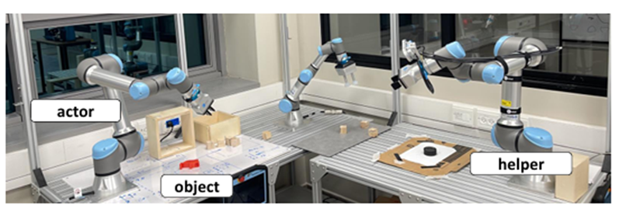
Current Projects @ CLAIR
Facilitating Collaboration in Multi-robot Systems
Multi-agent Reinforcement Learning for Energy Networks
Notes:
In multi-agent settings, we need to account not only for the interaction of an agent with its environment, but also for the agents’ interaction with each other. Here we have a joint policy, that considers the actions that are performed by other agents when deciding how to behave. In such settings, agents may have different goals and may need to cooperate or coordinate. In some cases, they may also need to negotiate or even compete with each other. Today, we will focus on the first two case, where agents share some motivation that dictates their interaction.

Slide 6
Robotics@CLAIR

Slide 7

Being Helpful & Trading Skills
task planning
Complex tasks - long-term reasoning
Dynamic and stochastic environments
Multiple-heterogeneous agents with mixed intentions
motion planning
Notes:
We have seen how we can use information shaping to figure out which information will allow a robot to achieve its goal. We can use this technique in a market of information, where robots can use information shaping to figure out which information is valuable to other agents. The robots in this setting need to localize, i.e. understand where they are in the environment, and also to navigate in the environment and can help each other with their tasks. For example, if a robot is near a location another robot is aiming for, it can divert from its own trajectory to check whether there are obstacles the other robot should know about. The helper robot needs to be rewarded for this helpful behavior, depending on the value of this information for the other robots and the degree of diversion from its own optimal behavior. This market based paradigm is beneficial both when agents are non-collaborative, but also in collaborative settings, where the local trade that occurs between agents relieves the need for a centralized controller to decide how agents should share information. I am working on this project with Elad Gershon, a masters student from Hebrew University who is co-advised by Jeff and myself, and with Kathryn Wantlin a senior from Harvard, who is co-advised by David Parkes and myself.

Slide 8
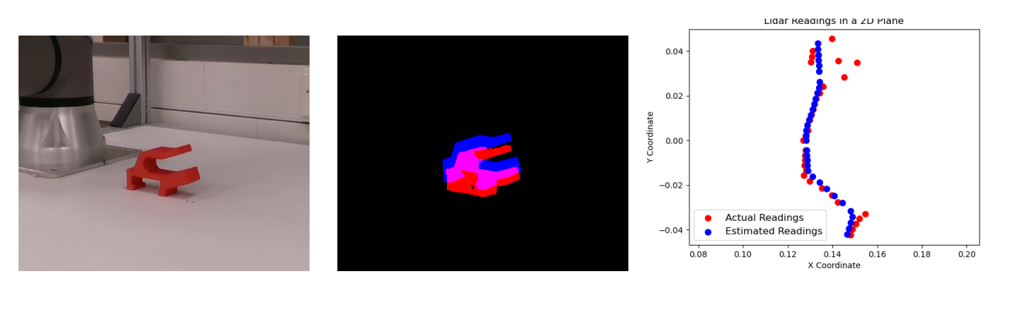
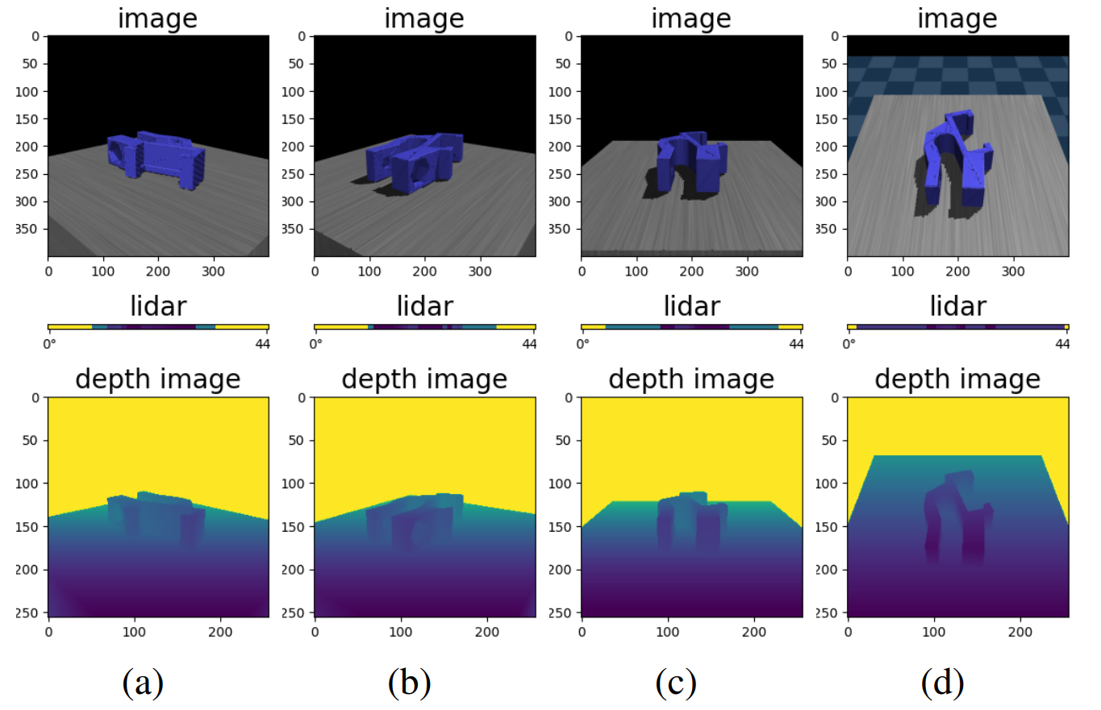
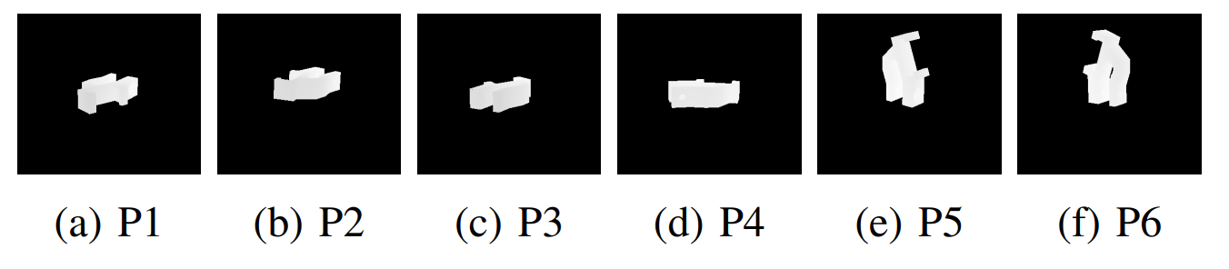
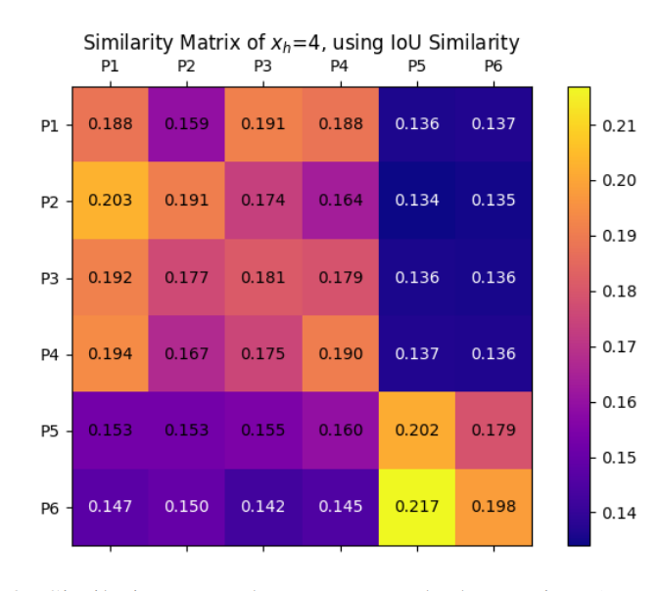
Value of Assistance (VOA) for Grasping
Mohammad Masarwy, Yuval Goshen, David Dovrat and Sarah Keren ​

Slide 9
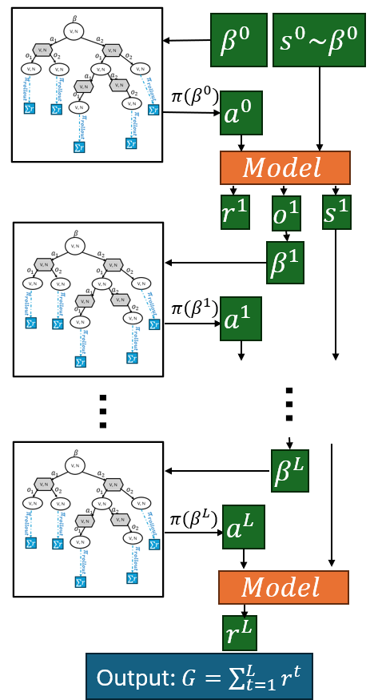
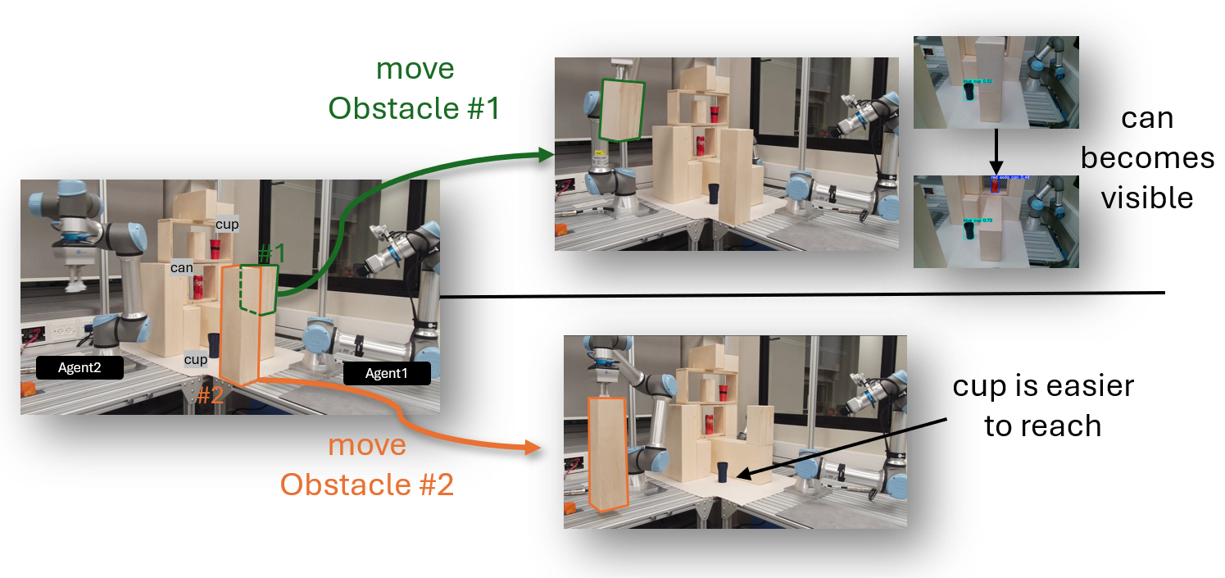
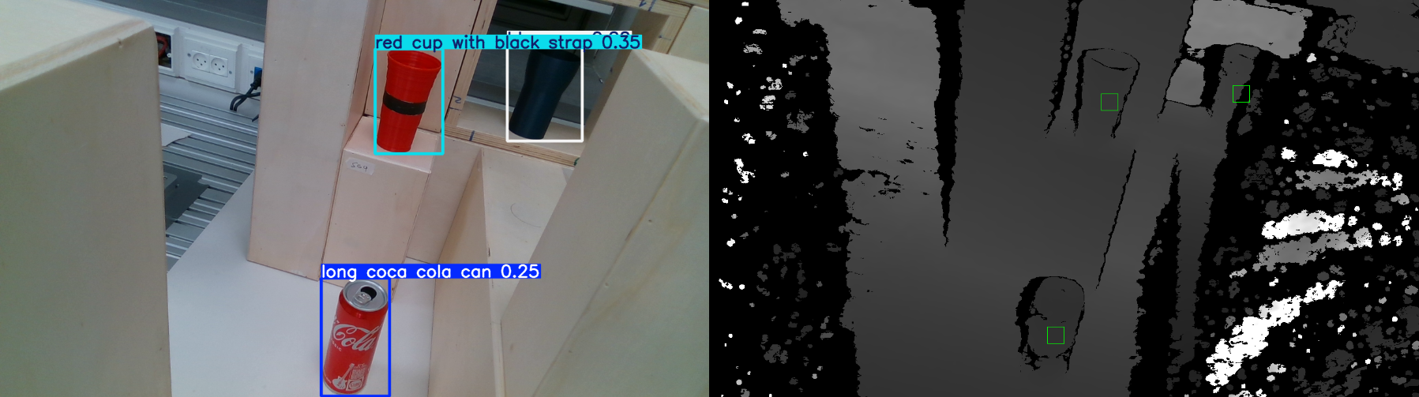
Estimating Value of Assistance for Online POMDP
Robotic Agents
Yuval Goshen and Sarah Keren ​

Slide 10
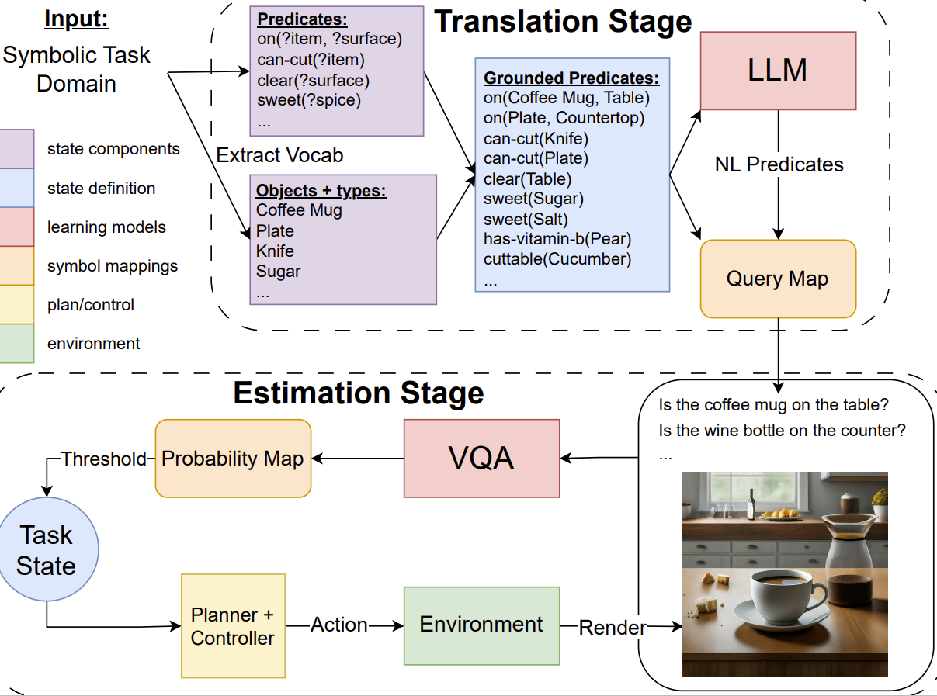
S3E: Semantic Symbolic State Estimation With
Vision-Language Foundation Models
Interventions considered: teleportation and localization information
Notes:
This research has a very rich and fascinating theoretical aspect to it, but it is also important to me to examine these approaches in practice. Both Eald and Kathryn have been working with me since the summer on multi-robot settings in which we can examine this market of information framework. Due to COVID-19, we have mainly been constrained to simulated domains, but as you can see here, Elad and I had the chance to meet in person and work on the actual robots. From Elad’s spontaneous burst of happiness, you can imagine how hard the transition was. However challenging, it is extremely important to me to make sure the theoretical tools that I am working on confront actual questions that come up in multi-robot settings.

Slide 11
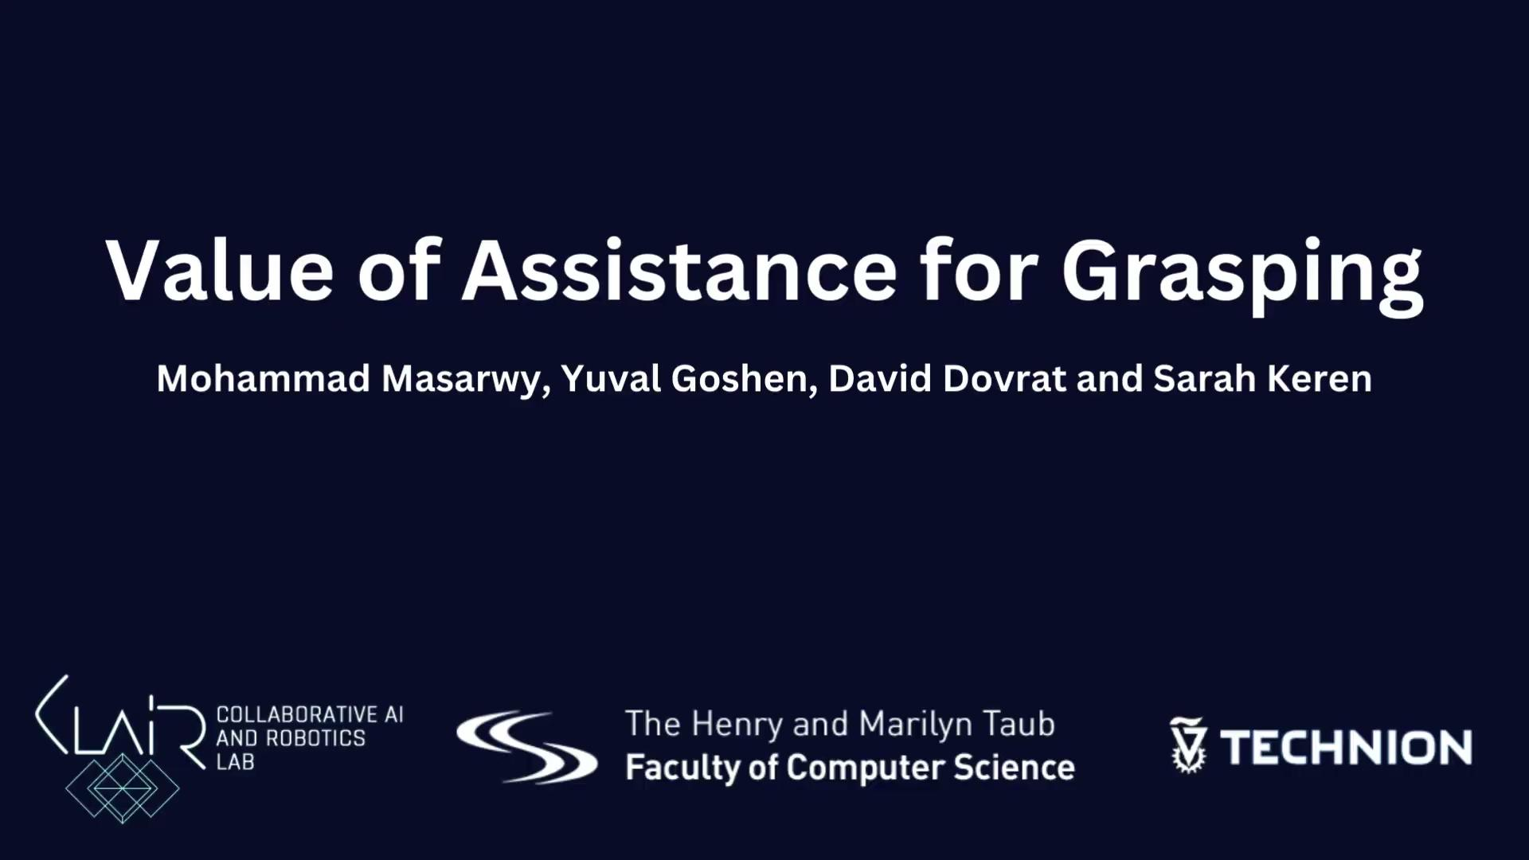
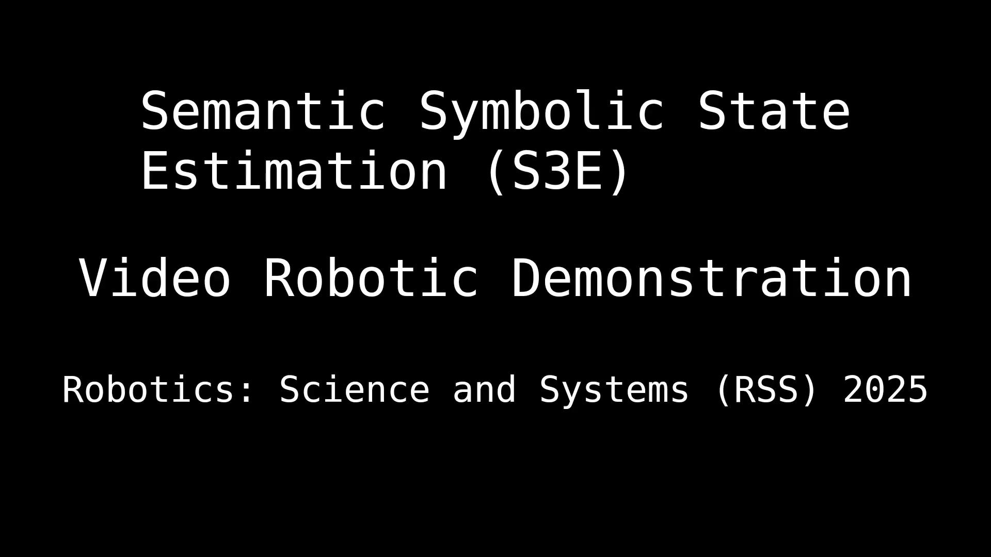
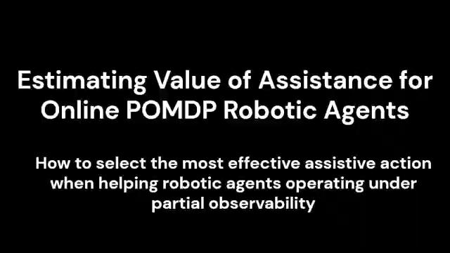
Multi-agent AI
Multi-agent Robotic Systems as Multi-agent AI
representing
Notes:
In multi-agent settings, we need to account not only for the interaction of an agent with its environment, but also for the agents’ interaction with each other. Here we have a joint policy, that considers the actions that are performed by other agents when deciding how to behave. In such settings, agents may have different goals and may need to cooperate or coordinate. In some cases, they may also need to negotiate or even compete with each other. Today, we will focus on the first two case, where agents share some motivation that dictates their interaction.

Slide 12
Energy Systems@CLAIR

Slide 13
Traditional vs. Modern Energy Systems Generation
Yesterday
Tomorrow
Centralized generation: Electricity flows from the power plant to the consumer.
Decentralized generation:
A mix of large and small-scale sources
Renewable energy: solar, wind, hydro
Electricity can flow in both directions, allowing for distributed generation and consumption.

Slide 14
Traditional vs. Modern Energy Systems Technologies
Yesterday
Tomorrow
Reliance on fossil fuels
Limited automation Manual monitoring and control of grid operations and older transmission infrastructure. Limited ability to dynamically adapt to changes in supply and demand dynamically.
Renewable energy resources solar, wind, hydro
Smart-grids Smart meters, and advanced sensors for real-time monitoring and control.

Slide 15
Traditional vs. Modern Energy Systems Energy Markets
Yesterday
Tomorrow
Passive consumers Little interaction or control over the consumer’s energy use.
Flat pricing Typically, flat rates for electricity consumption.
Active consumers (prosumers) Consumers can produce and sell energy back to the grid, becoming active participants.
Dynamic pricing Dynamic pricing models, such as time-of-use rates and real-time pricing, to encourage savings.

Slide 16
Traditional vs. Modern Energy Systems Energy Markets
Yesterday
Tomorrow
Regulated monopoly Often operated by regulated monopolies with limited competition
Static regulation Slow to adapt regulatory frameworks
Local and individual decision making and control
Competitive markets
Increased competition with multiple energy providers and market-based approaches.
New market structures More dynamic regulatory environment
New business models
Virtual power-plants
Aggregates
Energy communities

Slide 17

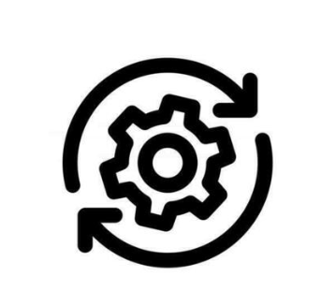
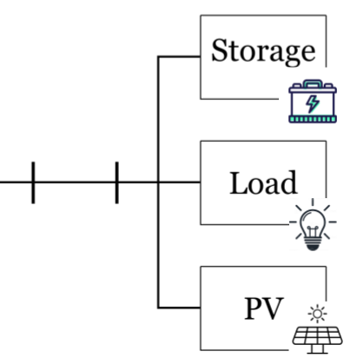

EnergyNet mechanism
ISO
prices, production plan
PCS units
predicated demand

Slide 18
Course Requirements

Slide 19
Course Requirements
There will be 3 more meetings in the CLAIR lab during the semester (at 14:00):
23/04 - Project proposal presentation
21/05 - Status report
09/07 - Project results presentation
Meetings during the semester with the T.As
Late Submission Exception:
In exceptional cases, we allow late submission after the start of the fall semester. In such cases, we cannot commit to a specific grading time frame. In particular, we cannot guarantee that the evaluation will be completed in time for the degree to be finalized and included in the graduation ceremony that same year.

Slide 20
Submission Date
There are 2 submission dates:
If you submit your work before 9/07 then you’ll receive your grades by the 31/07
If you submit your work before 31/08 then you’ll receive your grades by the first day of the fall semester.

Slide 21
Deliverables
Code base:
Github repository link - repository should be private
Repository permissions for T.A
All data related to project
Report
Link for final report template

Slide 22
Course communications
Course updates will be communicated through technion emails.

